Slide 1

Module 3: Protocols and Models
Introduction to Networks 7.0 (ITN)

Slide 2
Module Objectives
Module Title: Protocols and Models
Module Objective: Explain how network protocols enable devices to access local and remote
network resources.
Topic Title |  |  | Topic Objective
The Rules |  |  | Describe the types of rules that are necessary to successfully communicate.
Protocols |  |  | Explain why protocols are necessary in network communication.
Protocol Suites |  |  | Explain the purpose of adhering to a protocol suite.
Standards Organizations |  |  | Explain the role of standards organizations in establishing protocols for network interoperability.
Reference Models |  |  | Explain how the TCP/IP model and the OSI model are used to facilitate standardization in the communication process.
Data Encapsulation |  |  | Explain how data encapsulation allows data to be transported across the network.
Data Access |  |  | Explain how local hosts access local resources on a network.

Slide 3
Class Activity – Design a Communications System
Design a Communications System
Objectives:
Explain the role of protocols and standards organizations in facilitating interoperability in network communications.

Slide 4
3.1 The Rules

Slide 5
Communications Fundamentals
The Rules
Networks can vary in size and complexity. It is not enough to have a connection,
devices must agree on “how” to communicate.
There are three elements to any communication:
There will be a source (sender).
There will be a destination (receiver).
There will be a channel (media) that provides for the path of communications to occur.

Slide 6
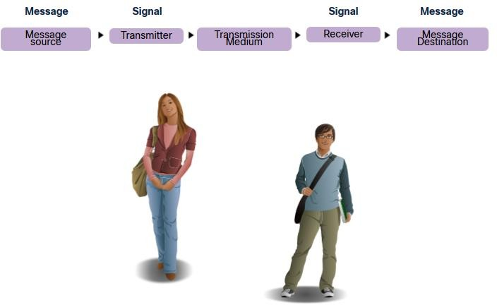
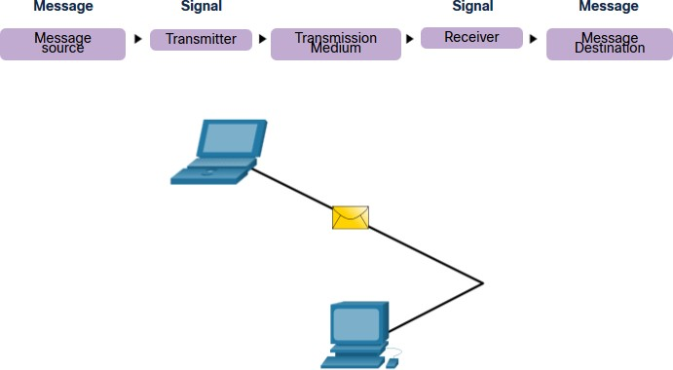
Communications Protocols
The Rules
All communications are governed by protocols.
Protocols are the rules that communications will follow.
These rules will vary depending on the protocol.

Slide 7
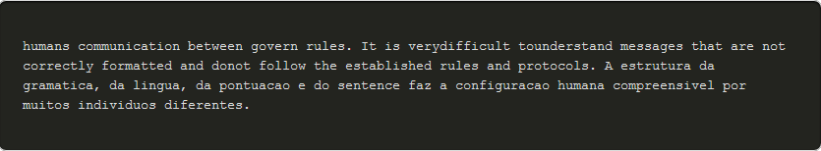
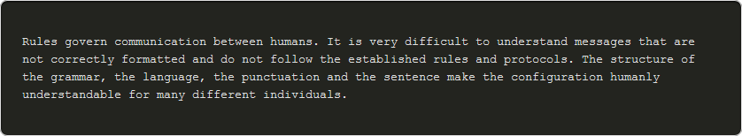
The Rules
Rule Establishment
Individuals must use established rules or agreements to govern the conversation.
The first message is difficult to read because it is not formatted properly. The second shows the message properly formatted

Slide 8
Rule Establishment (Cont.)
The Rules
Protocols must account for the following requirements:
An identified sender and receiver
Common language and grammar
Speed and timing of delivery
Confirmation or acknowledgment requirements

Slide 9
Network Protocol Requirements
The Rules
Common computer protocols must be in agreement and include the following requirements:
Message encoding
Message formatting and encapsulation
Message size
Message timing
Message delivery options

Slide 10
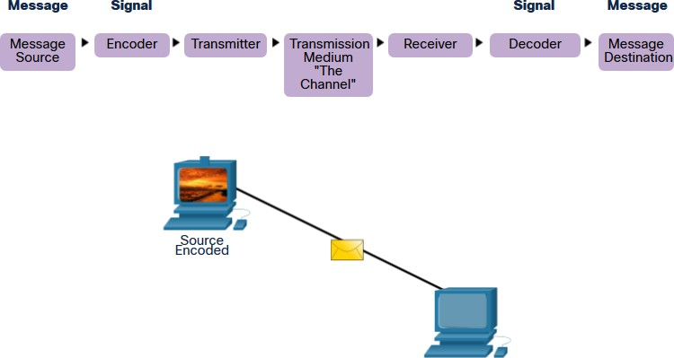
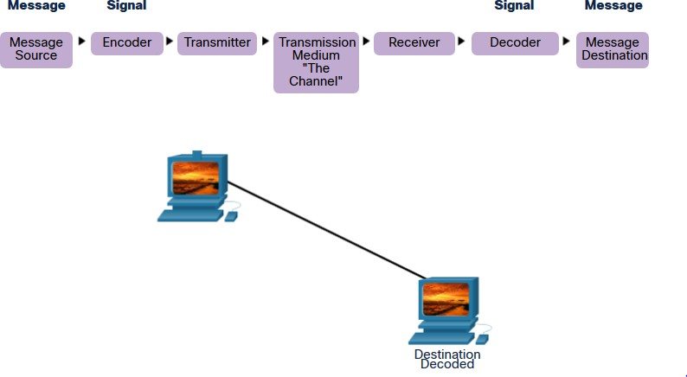
Message Encoding
The Rules
Encoding is the process of converting information into another acceptable form for
transmission.
Decoding reverses this process to interpret the information.

Slide 11
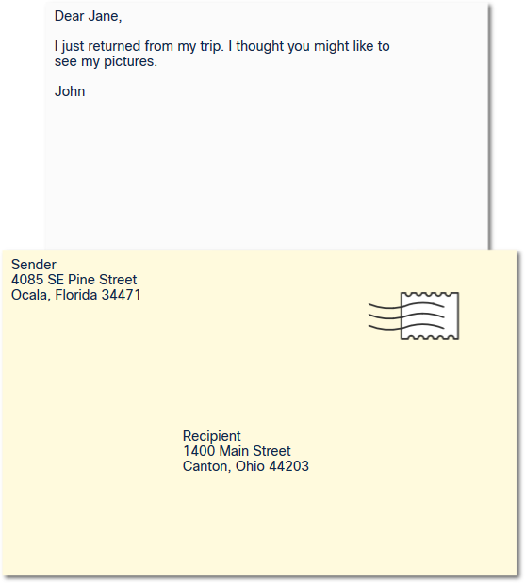
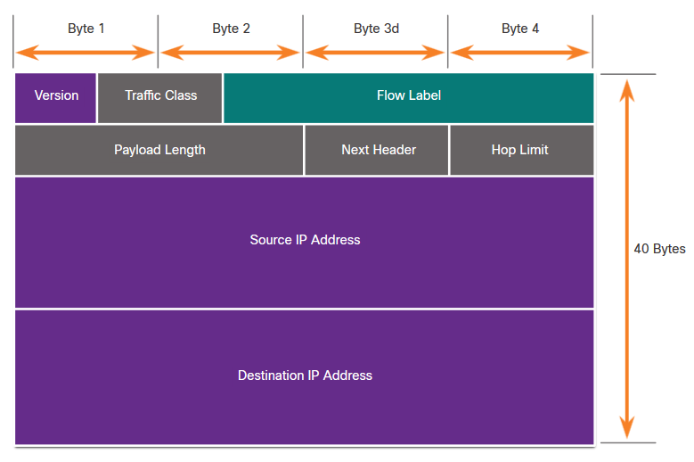
Message Formatting and Encapsulation
The Rules
When a message is sent, it must use a specific format or structure.
Message formats depend on the type of message and the channel that is used to deliver the message.

Slide 12
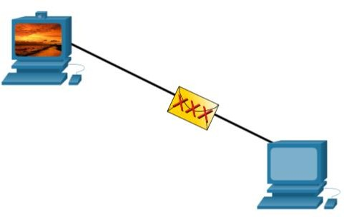
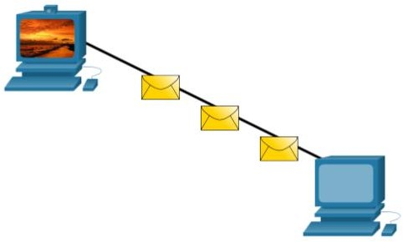
Message Size
The Rules
Encoding between hosts must be in an appropriate format for the medium.
Messages sent across the network are converted to bits
The bits are encoded into a pattern of light, sound, or electrical impulses.
The destination host must decode the signals to interpret the message.

Slide 13
Message Timing
The Rules
Message timing includes the following:
Flow Control – Manages the rate of data transmission and defines how much information can be sent and the speed at which it can be delivered.
Response Timeout – Manages how long a device waits when it does not hear a reply from
the destination.
Access method - Determines when someone can send a message.
There may be various rules governing issues like “collisions”. This is when more than one
device sends traffic at the same time and the messages become corrupt.
Some protocols are proactive and attempt to prevent collisions; other protocols are reactive and establish a recovery method after the collision occurs.

Slide 14
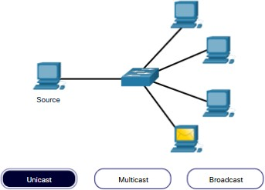
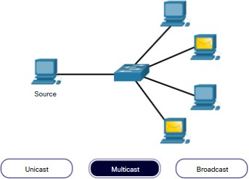
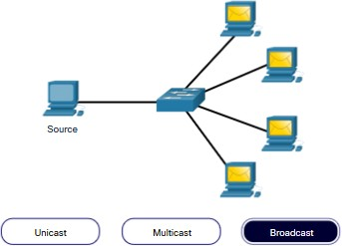
The Rules
Message Delivery Options
Message delivery may one of the following methods:
Unicast – one to one communication
Multicast – one to many, typically not all
Broadcast – one to all
Note: Broadcasts are used in IPv4 networks, but are not an option for IPv6. Later we will also see “Anycast” as an additional delivery option for IPv6.

Slide 15
3.2 Protocols

Slide 16
Network Protocol Overview
Protocols
Network protocols define a common set of rules.
Can be implemented on devices in:
  Software
  Hardware
  Both
Protocols have their own:
  Function
  Format
  Rules
Protocol Type | Description
Network Communications | enable two or more devices to communicate over one or more networks
Network Security | secure data to provide authentication, data integrity, and data encryption
Routing | enable routers to exchange route information, compare path information, and select best path
Service Discovery | used for the automatic detection of devices or services

Slide 17
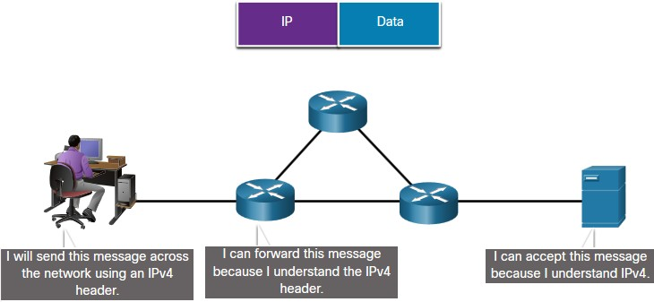
Protocols
Network Protocol Functions
Devices use agreed-upon protocols to communicate .
Protocols may have may have one or functions.
Function | Description
Addressing | Identifies sender and receiver
Reliability | Provides guaranteed delivery
Flow Control | Ensures data flows at an efficient rate
Sequencing | Uniquely labels each transmitted segment of data
Error Detection | Determines if data became corrupted during transmission
Application Interface | Process-to-process communications between network applications

Slide 18
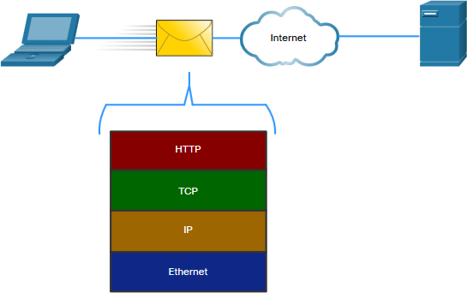
Protocol Interaction
Protocols
Networks require the use of several
protocols.
Each protocol has its own function and format.
Protocol | Function
Hypertext Transfer Protocol (HTTP) | Governs the way a web server and a web client interact Defines content and format
Transmission Control Protocol (TCP) | Manages the individual conversations Provides guaranteed delivery Manages flow control
Internet Protocol (IP) | Delivers messages globally from the sender to the receiver
Ethernet | Delivers messages from one NIC to another NIC on the same Ethernet Local Area Network (LAN)

Slide 19
3.3 Protocol Suites

Slide 20
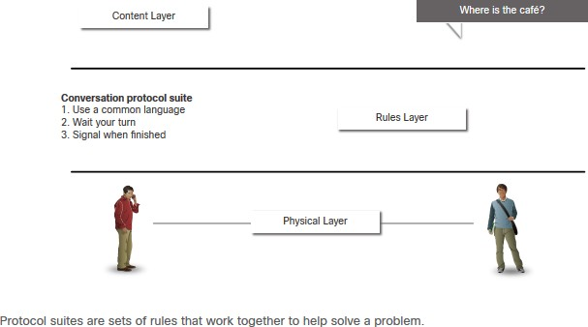
Network Protocol Suites
Protocol Suites
Protocols must be able to work with other protocols.
Protocol suite:
A group of inter-related protocols necessary to perform a communication function
Sets of rules that work together to help solve a problem
The protocols are viewed in terms of layers:
Higher Layers
Lower Layers- concerned with moving data and provide services to upper layers

Slide 21
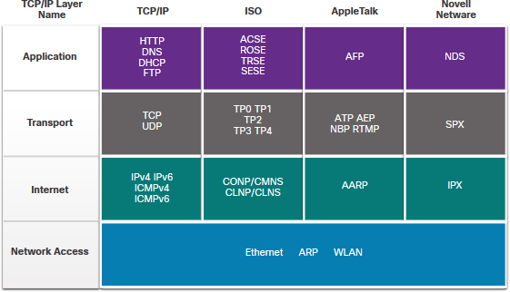
Protocol Suites
Evolution of Protocol Suites
There are several protocol suites.
Internet Protocol Suite or TCP/IP- The most common protocol suite and maintained by the Internet Engineering Task Force (IETF)
Open Systems Interconnection (OSI) protocols- Developed by the International Organization for Standardization (ISO) and the International Telecommunications Union (ITU)
AppleTalk- Proprietary suite release by
Apple Inc.
Novell NetWare- Proprietary suite developed by Novell Inc.

Slide 22
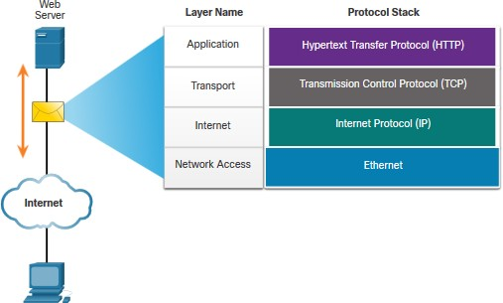
TCP/IP Protocol Example
Protocol Suites
TCP/IP protocols operate at the application, transport, and internet layers.
The most common network access layer LAN protocols are Ethernet and WLAN (wireless LAN).

Slide 23
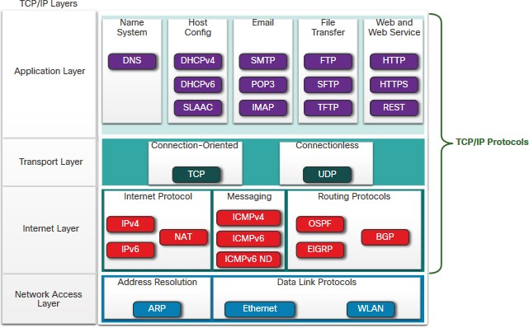
Protocol Suites
TCP/IP Protocol Suite
TCP/IP is the protocol suite used by the internet and includes many protocols.
TCP/IP is:
  An open standard protocol suite that is freely available to the public and can be used by any vendor
  A standards-based protocol suite that is endorsed by the networking industry and approved by a standards organization to ensure interoperability

Slide 24
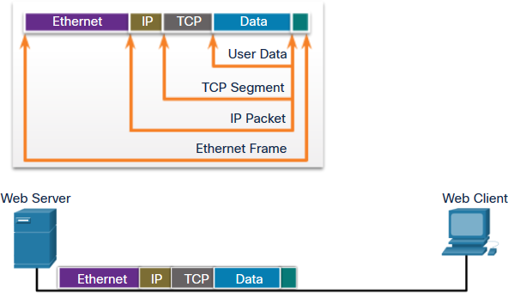
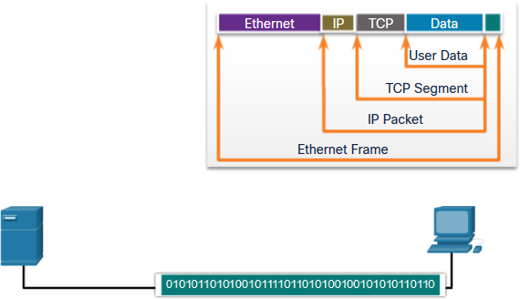
Protocol Suites
TCP/IP Communication Process
A web server encapsulating and sending a web page to a client.
A client de-encapsulating the web page for the web browser

Slide 25
3.4 Standards Organizations

Slide 26
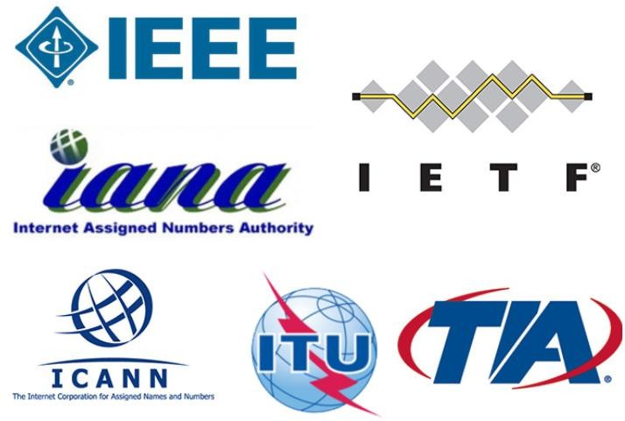
Open Standards
Standards Organizations
Open standards encourage:
interoperability
competition
innovation
Standards organizations are:
vendor-neutral
non-profit organizations
established to develop and promote the
concept of open standards.

Slide 27
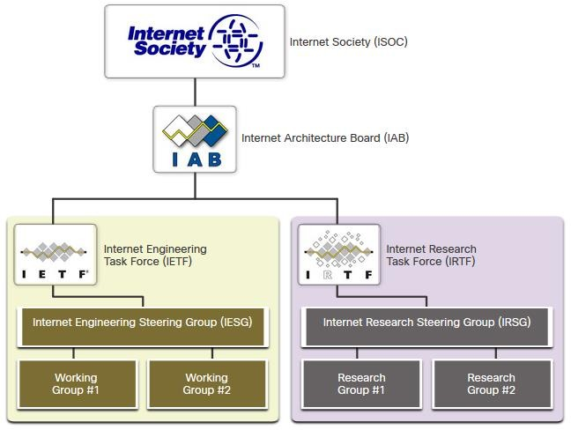
Standards Organizations
Internet Standards
Internet Society (ISOC) - Promotes the open development and evolution of internet
Internet Architecture Board (IAB) - Responsible for management and development of internet standards
Internet Engineering Task Force (IETF) - Develops, updates, and maintains internet and TCP/IP technologies
Internet Research Task Force (IRTF) - Focused on long-term research related to internet and TCP/IP protocols

Slide 28
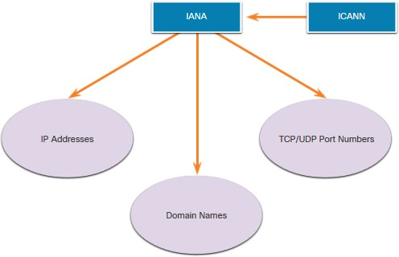
Internet Standards (Cont.)
Standards Organizations
Standards organizations involved with the development and support of TCP/IP
Internet Corporation for Assigned Names and Numbers (ICANN) - Coordinates IP address allocation, the management of domain names, and assignment of other information
Internet Assigned Numbers Authority (IANA) - Oversees and manages IP address allocation, domain name management, and protocol identifiers for ICANN

Slide 29
Electronic and Communications Standards
Standards Organizations
Institute of Electrical and Electronics Engineers (IEEE, pronounced “I-triple-E”)
- dedicated to creating standards in power and energy, healthcare,
telecommunications, and networking
Electronic Industries Alliance (EIA) - develops standards relating to electrical wiring, connectors, and the 19-inch racks used to mount networking equipment
Telecommunications Industry Association (TIA) - develops communication standards in radio equipment, cellular towers, Voice over IP (VoIP) devices, satellite communications, and more
International Telecommunications Union-Telecommunication Standardization Sector (ITU-T) - defines standards for video compression, Internet Protocol Television (IPTV), and broadband communications, such as a digital subscriber line (DSL)

Slide 30
3.5 Reference Models

Slide 31
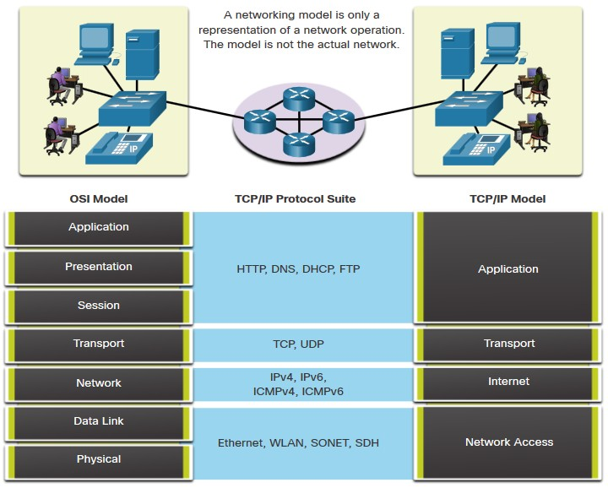
The Benefits of Using a Layered Model
Reference Models
Complex concepts such as how a network operates can be difficult to explain and understand. For this reason, a layered model is used.
Two layered models describe network
operations:
Open System Interconnection (OSI)
Reference Model
TCP/IP Reference Model

Slide 32
The Benefits of Using a Layered Model (Cont.)
Reference Models
These are the benefits of using a layered model:
Assist in protocol design because protocols that operate at a specific layer have defined information that they act upon and a defined interface to the layers above and below
Foster competition because products from different vendors can work together
Prevent technology or capability changes in one layer from affecting other layers
above and below
Provide a common language to describe networking functions and capabilities

Slide 33
The OSI Reference Model
Reference Models
OSI Model Layer | Description
7 - Application | Contains protocols used for process-to-process communications.
6 - Presentation | Provides for common representation of the data transferred between application layer services.
5 - Session | Provides services to the presentation layer and to manage data exchange.
4 - Transport | Defines services to segment, transfer, and reassemble the data for individual communications.
3 - Network | Provides services to exchange the individual pieces of data over the network.
2 - Data Link | Describes methods for exchanging data frames over a common media.
1 - Physical | Describes the means to activate, maintain, and de-activate physical connections.

Slide 34
The TCP/IP Reference Model
Reference Models
TCP/IP Model Layer | Description
Application | Represents data to the user, plus encoding and dialog control.
Transport | Supports communication between various devices across diverse networks.
Internet | Determines the best path through the network.
Network Access | Controls the hardware devices and media that make up the network.

Slide 35
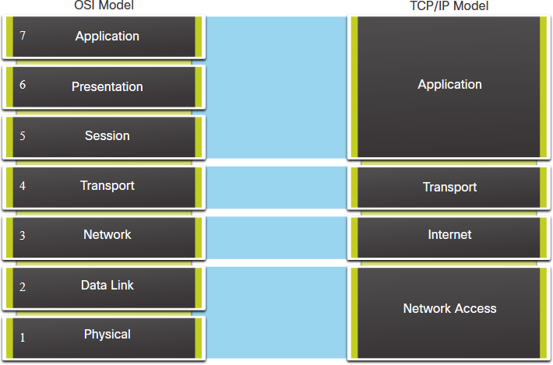
OSI and TCP/IP Model Comparison
Reference Models
The OSI model divides the network access layer and the application layer of the TCP/IP model into multiple layers.
The TCP/IP protocol suite does not specify which protocols to use when transmitting over a physical medium.
OSI Layers 1 and 2 discuss the necessary procedures to access the media and the physical means to send data over a network.

Slide 36
3.6 Data Encapsulation

Slide 37
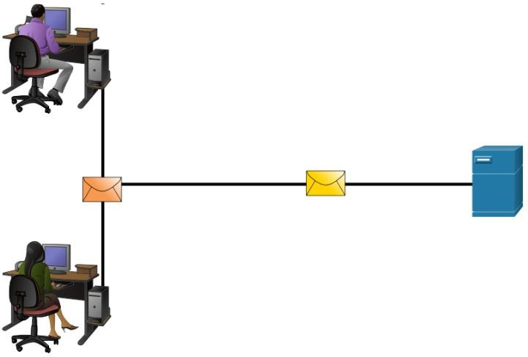
Segmenting Messages
Data Encapsulation
Segmenting is the process of breaking up messages into smaller units. Multiplexing is the processes of taking multiple streams of segmented data and interleaving them together.
Segmenting messages has two primary
benefits:
Increases speed - Large amounts of data can be sent over the network without tying up a communications link.
Increases efficiency - Only segments which fail to reach the destination need to be retransmitted, not the entire data stream.

Slide 38
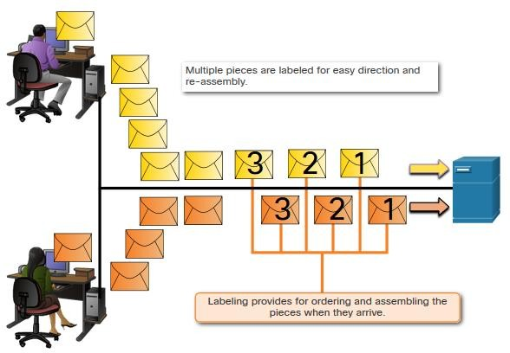
Sequencing
Data Encapsulation
Sequencing messages is the process of numbering the segments so that the message may be reassembled at the destination.
TCP is responsible for sequencing the
individual segments.

Slide 39
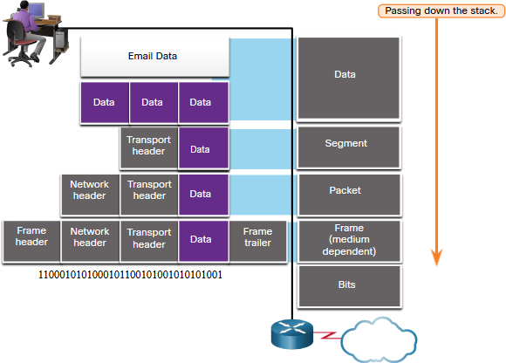
Data Encapsulation
Protocol Data Units
Encapsulation is the process where protocols add their information to the data.
At each stage of the process, a PDU has a different name to reflect its new functions.
There is no universal naming convention for PDUs, in this course, the PDUs are named according to the protocols of the TCP/IP suite.
PDUs passing down the stack are as
follows:
Data (Data Stream)
Segment
Packet
Frame
Bits (Bit Stream)

Slide 40
Encapsulation Example
Data Encapsulation
Encapsulation is a top down process.
The level above does its process and then passes it down to the next level of the model. This process is repeated by each layer until it is sent out as a bit stream.

Slide 41
De-encapsulation Example
Data Encapsulation
Data is de-encapsulated as it moves up the stack.
When a layer completes its process, that layer strips off its header and passes it up to the next level to be processed. This is repeated at each layer until it is a data stream that the application can process.
  Received as Bits (Bit Stream)
  Frame
  Packet
  Segment
  Data (Data Stream)

Slide 42
3.7 Data Access

Slide 43
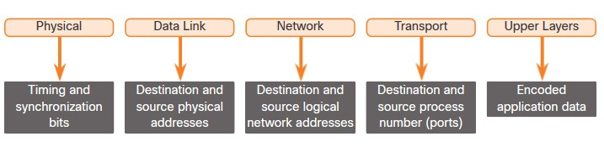
Addresses
Data Access
Both the data link and network layers use addressing to deliver data from source to destination.
Network layer source and destination addresses - Responsible for delivering the IP
packet from original source to the final destination.
Data link layer source and destination addresses – Responsible for delivering the data link frame from one network interface card (NIC) to another NIC on the same network.

Slide 44
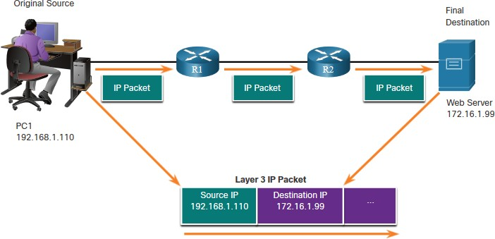
Layer 3 Logical Address
Data Access
The IP packet contains two IP addresses:
Source IP address - The IP address of the sending device, original source of the packet.
Destination IP address - The IP address of the receiving device, final destination of the packet.
These addresses may be on the same link or remote.

Slide 45
Layer 3 Logical Address (Cont.)
Data Access
An IP address contains two parts:
Network portion (IPv4) or Prefix (IPv6)
  The left-most part of the address indicates the network group which the IP address is a member.
  Each LAN or WAN will have the same network portion.
Host portion (IPv4) or Interface ID
(IPv6)
  The remaining part of the address identifies a specific device within the group.
  This portion is unique for each device on the network.

Slide 46
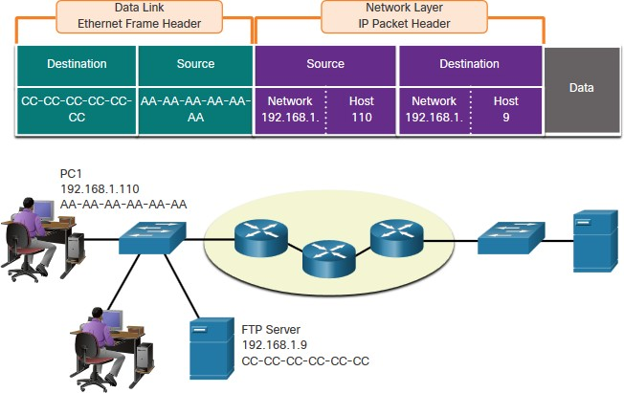
Devices on the Same Network
Data Access
When devices are on the same network the source and destination will have the same number in network portion of the address.
PC1 – 192.168.1.110
FTP Server – 192.168.1.9

Slide 47
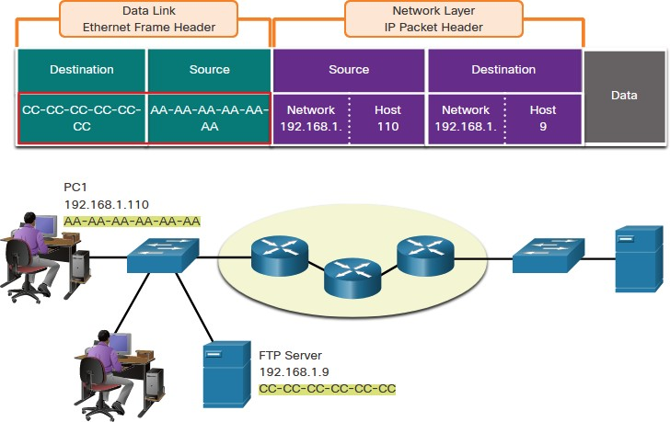
Role of the Data Link Layer Addresses: Same IP Network
Data Access
When devices are on the same Ethernet network the data link frame will use the actual MAC address of the destination NIC.
MAC addresses are physically embedded into the Ethernet NIC and are local addressing.
The Source MAC address will be that of
the originator on the link.
The Destination MAC address will always be on the same link as the source, even if the ultimate destination is remote.

Slide 48
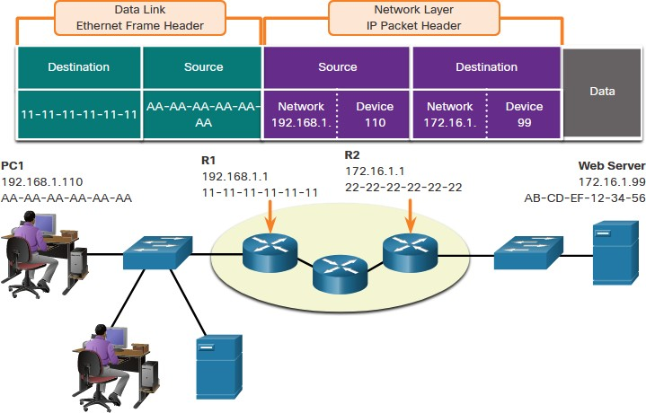
Devices on a Remote Network
Data Access
What happens when the actual (ultimate) destination is not on the same LAN and is remote?
What happens when PC1 tries to reach the Web Server?
Does this impact the network and data link layers?

Slide 49
Role of the Network Layer Addresses
Data Access
When the source and destination have a different network portion, this means they are on different networks.
PC1 – 192.168.1
Web Server – 172.16.1

Slide 50
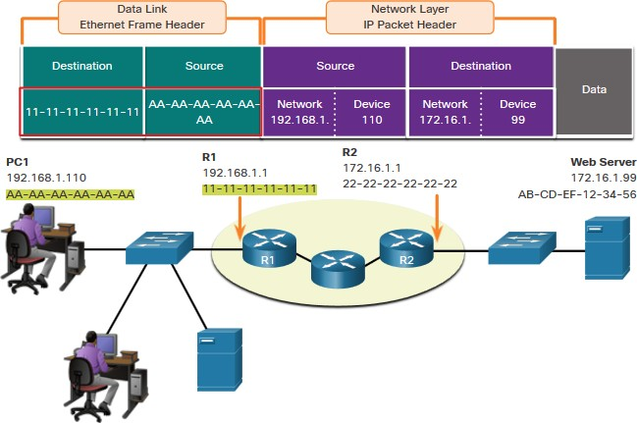
Role of the Data Link Layer Addresses: Different IP Networks
Data Access
When the final destination is remote, Layer 3 will provide Layer 2 with the local default gateway IP address, also known as the router address.
The default gateway (DGW) is the router interface IP address that is part of this LAN and will be the “door” or “gateway” to all other remote locations.
All devices on the LAN must be told about this address or their traffic will be confined to the LAN only.
Once Layer 2 on PC1 forwards to the default gateway (Router), the router then can start the routing process of getting the information to actual destination.

Slide 51
Role of the Data Link Layer Addresses: Different IP Networks
(Cont.)
Data Access
The data link addressing is local addressing so it will have a source and destination for each link.
The MAC addressing for the first
segment is :
  Source – AA-AA-AA-AA-AA-AA (PC1) Sends the frame.
  Destination – 11-11-11-11-11-11 (R1- Default Gateway MAC) Receives the frame.
Note: While the L2 local addressing will change from link to link or hop to hop, the L3 addressing remains the same.

Slide 52
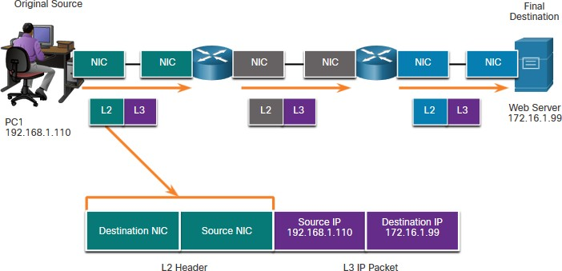
Data Access
Data Link Addresses
Since data link addressing is local addressing, it will have a source and destination for
each segment or hop of the journey to the destination.
The MAC addressing for the first segment is:
  Source – (PC1 NIC) sends frame
  Destination – (First Router- DGW interface) receives frame

Slide 53
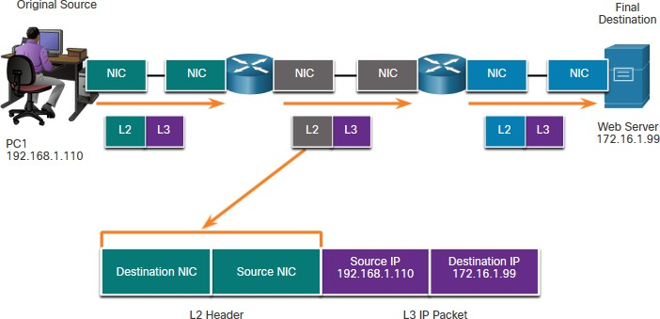
Data Access
Data Link Addresses (Cont.)
The MAC addressing for the second hop is:
Source – (First Router- exit interface) sends frame
Destination – (Second Router) receives frame

Slide 54
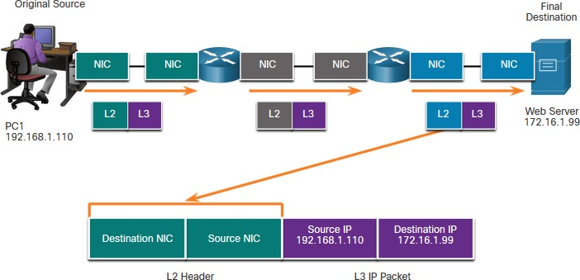
Data Access
Data Link Addresses (Cont.)
The MAC addressing for the last segment is:
Source – (Second Router- exit interface) sends frame
Destination – (Web Server NIC) receives frame

Slide 55
Data Access
Data Link Addresses (Cont.)
Notice that the packet is not modified, but the frame is changed, therefore the L3 IP
addressing does not change from segment to segment like the L2 MAC addressing.
The L3 addressing remains the same since it is global and the ultimate destination is still the Web Server.

Slide 56
Lab – Install Wireshark
Data Access
In this lab you will do the following:
Download and Install Wireshark

Slide 57
Lab – Use Wireshark to View Network Traffic
Data Access
In this lab, you will do the following:
Part 1: Capture and Analyze Local ICMP Data in Wireshark
Part 2: Capture and Analyze ICMP Data in Wireshark

Slide 58
3.8 Module Practice and Quiz

Slide 59
What did I learn in this module?
Module Practice and Quiz
The Rules
Protocols must have a sender and a receiver.
Common computer protocols include these requirements: message encoding, formatting
and encapsulation, size, timing, and delivery options.
Protocols
To send a message across the network requires the use of several protocols.
Each network protocol has its own function, format, and rules for communications.
Protocol Suites
A protocol suite is a group of inter-related protocols.
TCP/IP protocol suite are the protocols used today.
Standards Organizations
Open standards encourage interoperability, competition, and innovation.

Slide 60
Module Practice and Quiz
What did I learn in this module? (Cont.)
Reference Models
The two models used in networking are the TCP/IP and the OSI model.
The TCP/IP model has 4 layers and the OSI model has 7 layers.
Data Encapsulation
The form that a piece of data takes at any layer is called a protocol data unit (PDU).
There are five different PDUs used in the data encapsulation process: data, segment, packet, frame, and bits
Data Access
The Network and Data Link layers are going to provide addressing to move data through the network.
Layer 3 will provide IP addressing and layer 2 will provide MAC addressing.
The way these layers handle addressing will depend on whether the source and the destination are on the same network or if the destination is on a different network from the source.

Slide 61


